Slide 2
Diving into Mastery Guidance for Educators
Each activity sheet is split into three sections, diving, deeper and deepest, which are represented by the following icons:
These carefully designed activities take your children through a learning journey, initially ensuring they are fluent with the key concept being taught; then applying this to a range of reasoning and problem-solving activities.
These sheets might not necessarily be used in a linear way. Some children might begin at the ‘Deeper’ section and in fact, others may ‘dive straight in’ to the ‘Deepest’ section if they have already mastered the skill and are applying this to show their depth of understanding.
Diving
Deeper
Deepest

Slide 3
National Curriculum Objective(s)
Identify right angles, recognise that two right angles make a half-turn, three make three quarters of a turn and four a complete turn; identify whether angles are greater than or less than a right angle.

Slide 4
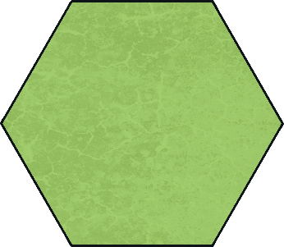
Turns and Angles
Diving
An angle is made when two straight lines meet.
Each of these pictures shows one or more angles.

Slide 5
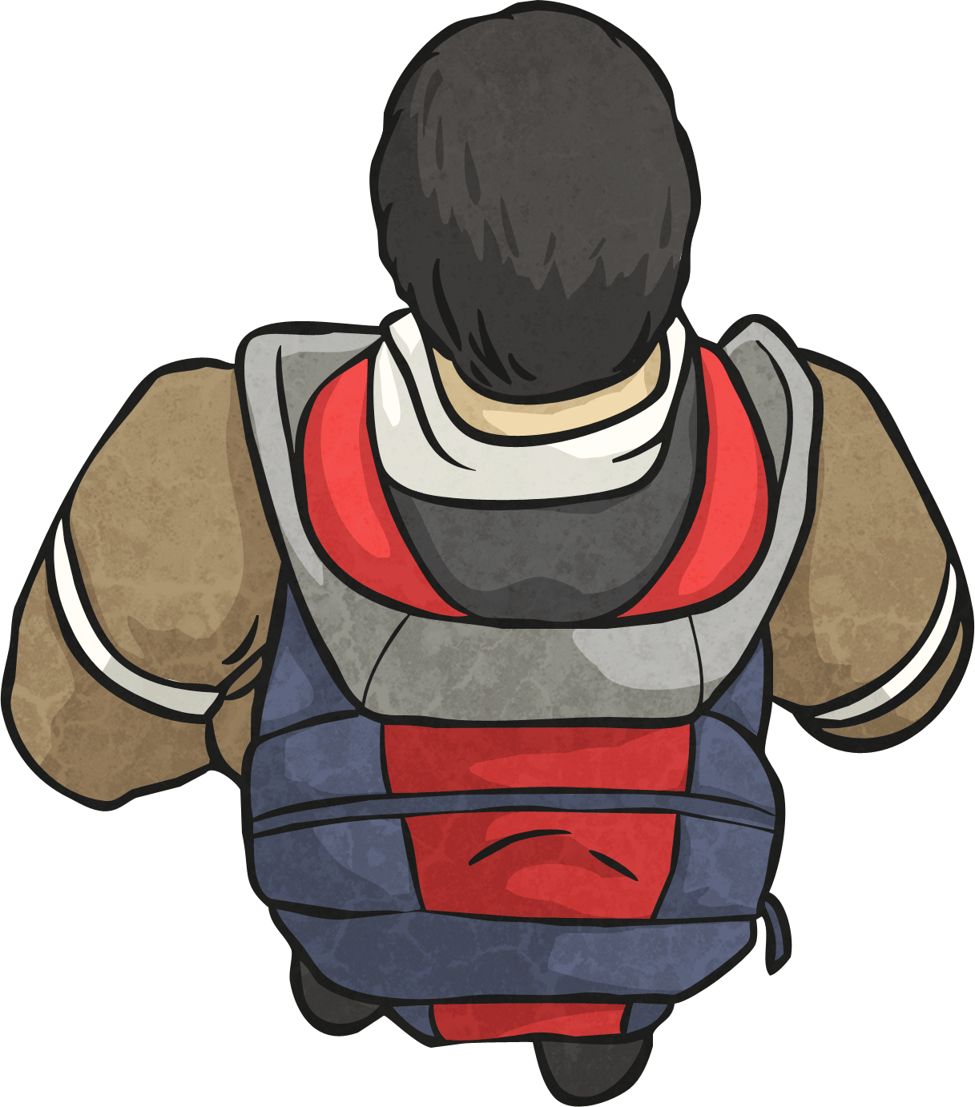
Turns and Angles
Diving
A right angle is made when two lines meet like this:
A quarter turn looks like this:
The size of a right angle is 90°.
When something makes a quarter turn, it turns 90°.

Slide 6
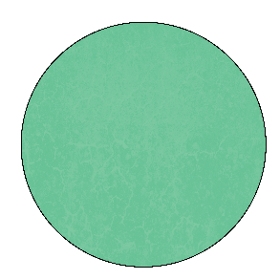
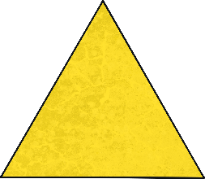
Turns and Angles
Deeper
The child is facing the circle. If they make a quarter turn clockwise, which shape will they be facing?

Slide 7
Turns and Angles
Deeper
The child is facing the rectangle. If they make a three-quarter turn anticlockwise, which shape will they be facing?

Slide 8
Turns and Angles
Deepest
The child makes a quarter turn clockwise to face the circle.
Is there another way he could have turned to end up in the same position?

Slide 9
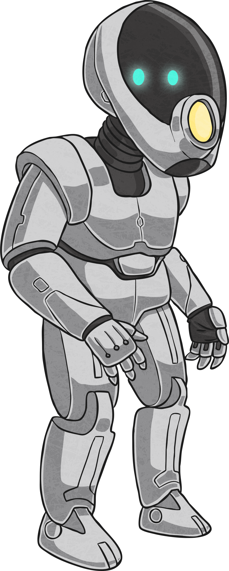
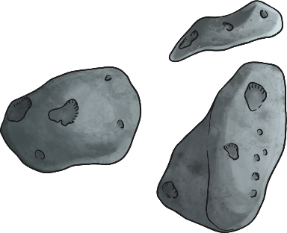
Turns and Angles
Deepest
What turning instructions would you give to the robot to escape the maze?

Slide 10
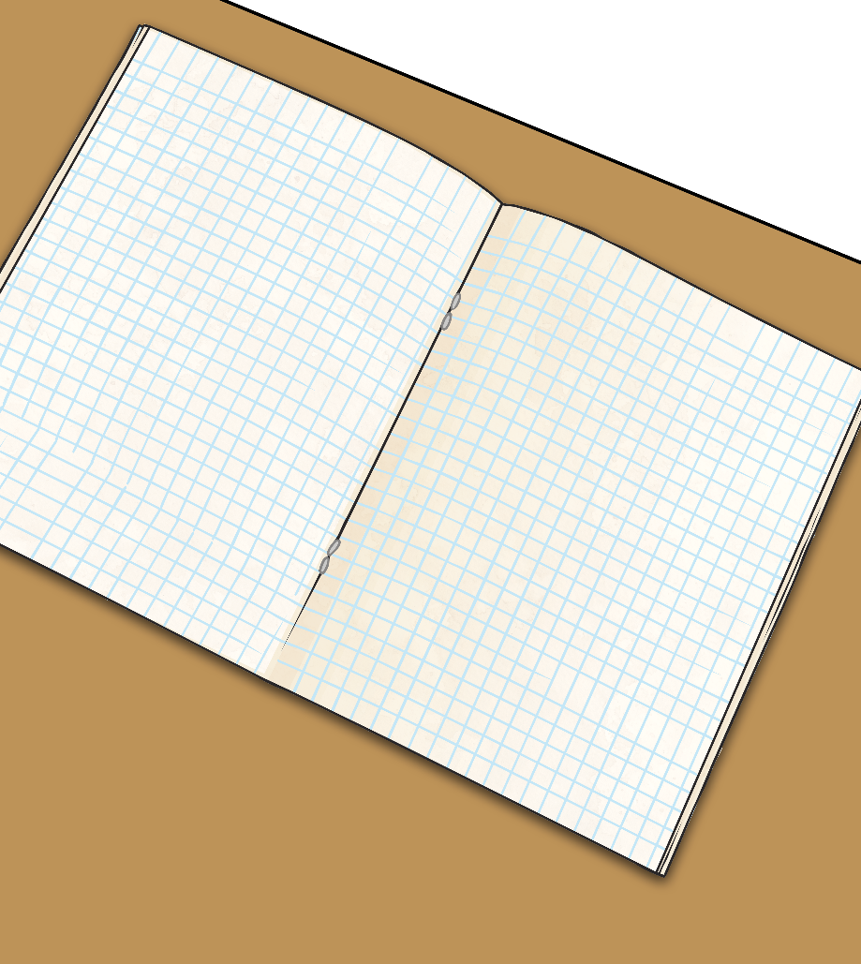
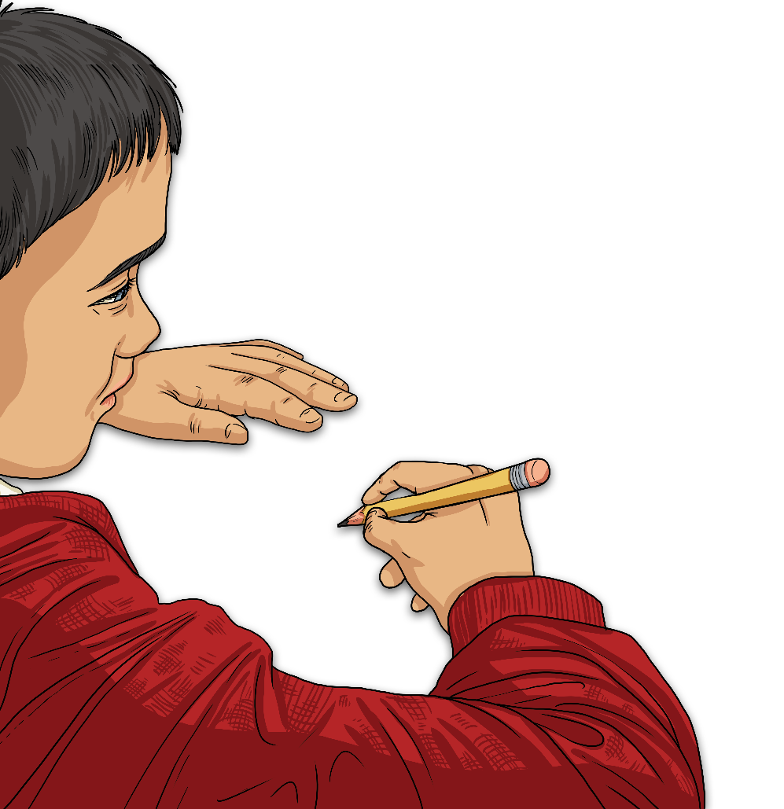
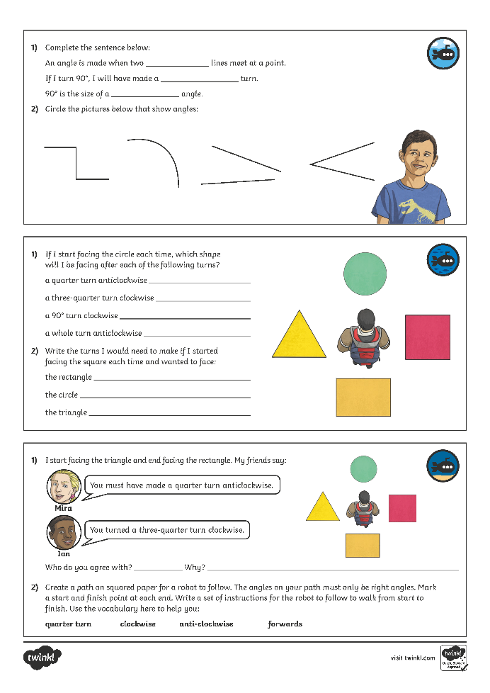
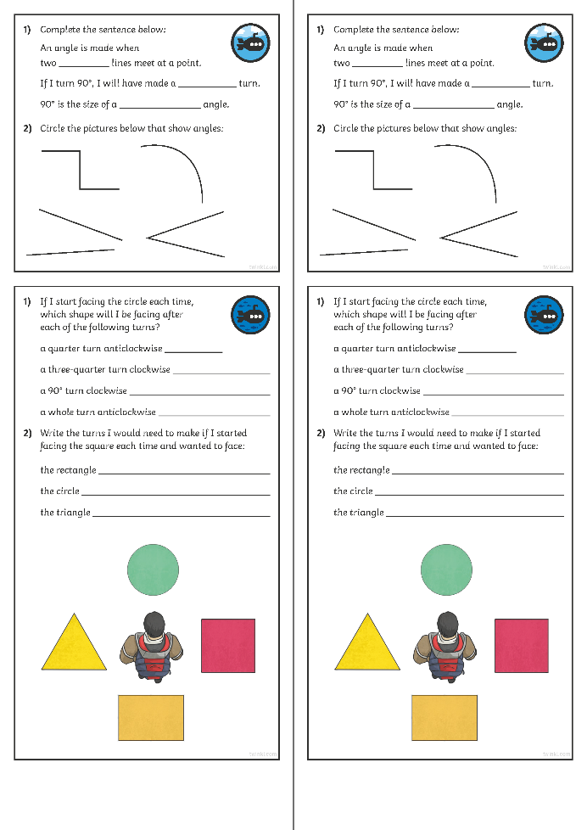
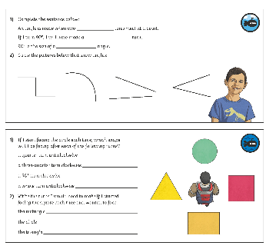
Turns and Angles
Dive in by completing your own activity!

Slide 11
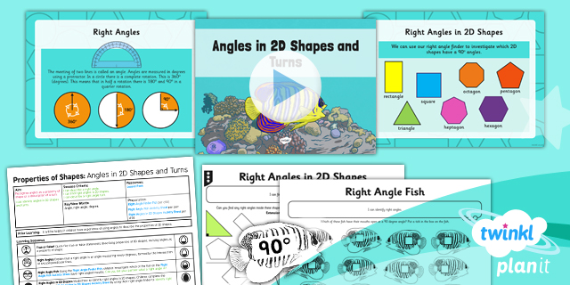
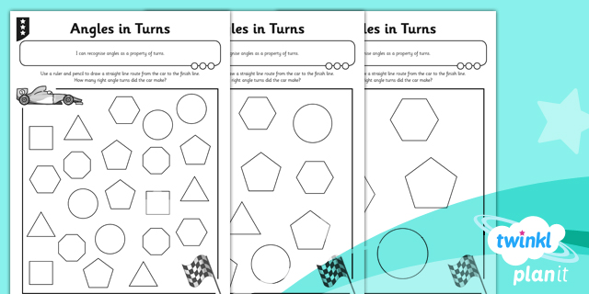
Need Planning to Complement this Resource?
National Curriculum Aim
Identify right angles, recognise that two right angles make a half-turn, three make three quarters of a turn and four a complete turn; identify whether angles are greater than or less than a right angle.
For more planning resources to support this aim, click here.
Twinkl PlanIt is our award-winning scheme of work with over 4000 resources.

