Slide 2
Diving into Mastery Guidance for Educators
Each activity sheet is split into three sections, diving, deeper and deepest, which are represented by the following icons:
These carefully designed activities take your children through a learning journey, initially ensuring they are fluent with the key concept being taught; then applying this to a range of reasoning and problem-solving activities.
These sheets might not necessarily be used in a linear way. Some children might begin at the ‘Deeper’ section and in fact, others may ‘dive straight in’ to the ‘Deepest’ section if they have already mastered the skill and are applying this to show their depth of understanding.
Diving
Deeper
Deepest

Slide 3
National Curriculum Objective(s)
Draw 2-D shapes and make 3-D shapes using modelling materials; recognise 3-D shapes in different orientations and describe them.

Slide 4
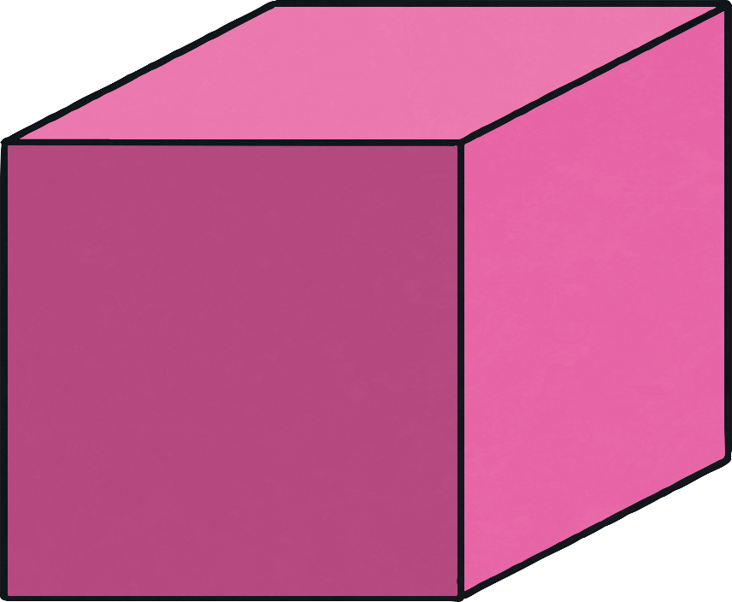
Recognise and Describe 3D Shapes
Diving
To describe 3D shapes, we talk about faces, edges and vertices:
height
length
width
Every 3D shape has three measurements. These are length, height and width.

Slide 5
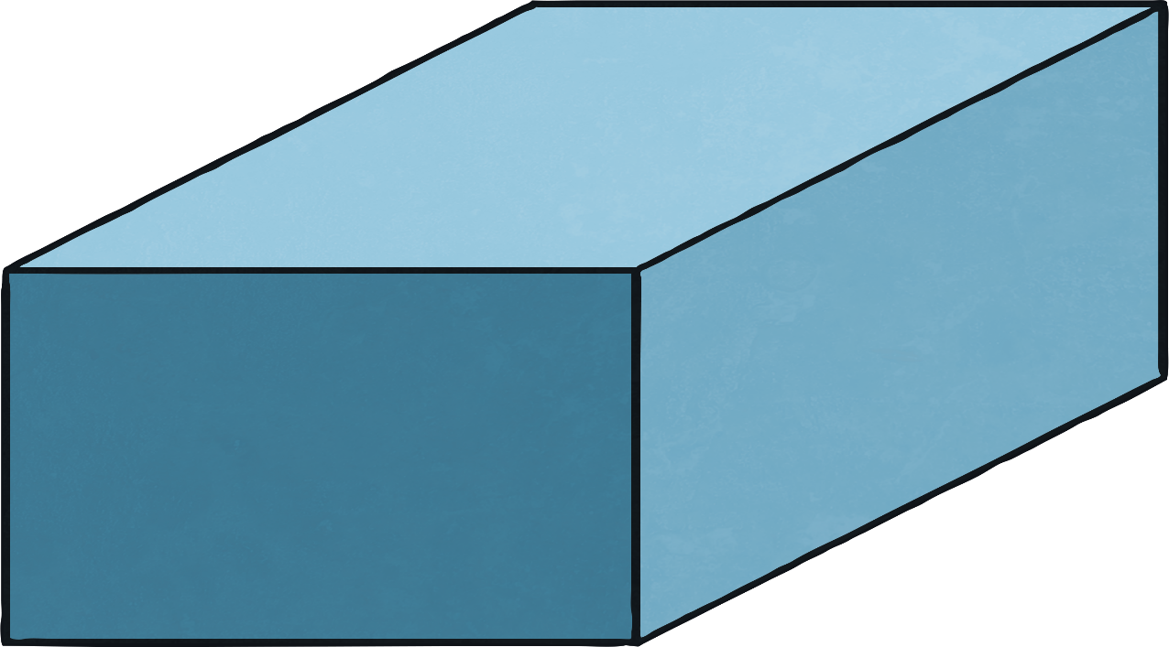
Recognise and Describe 3D Shapes
Diving
faces
Faces are the flat sides on a shape. This cuboid has six rectangle faces.

Slide 6
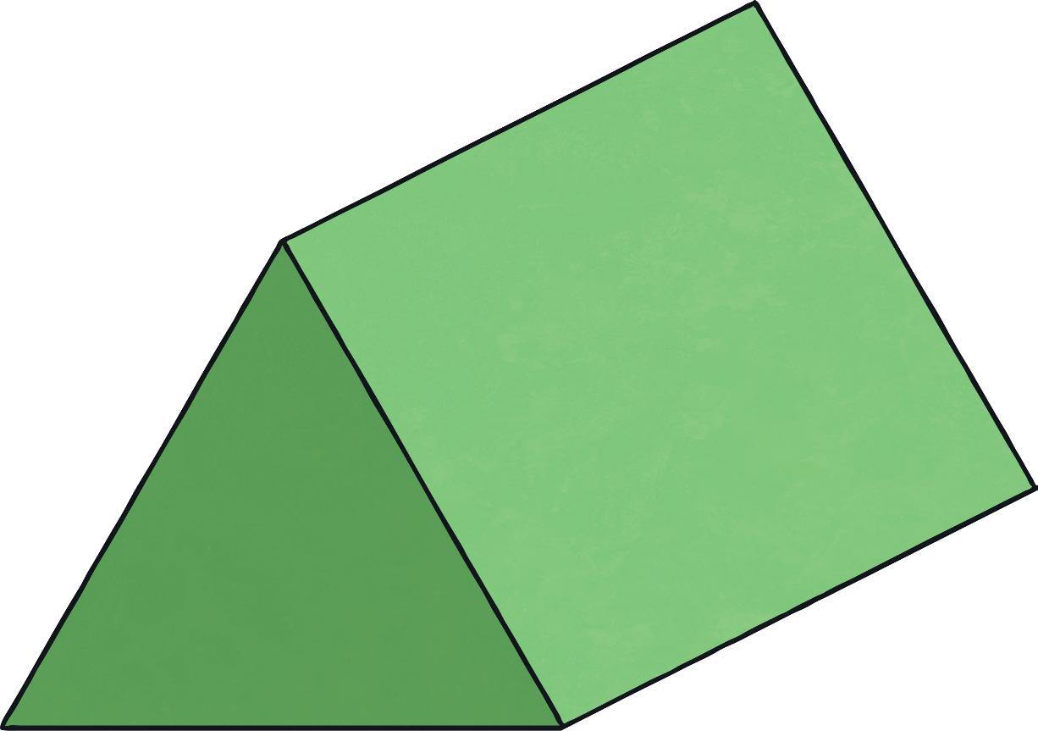
Recognise and Describe 3D Shapes
Diving
edges
Edges are the lines where two faces meet. A triangular prism has nine edges.

Slide 7
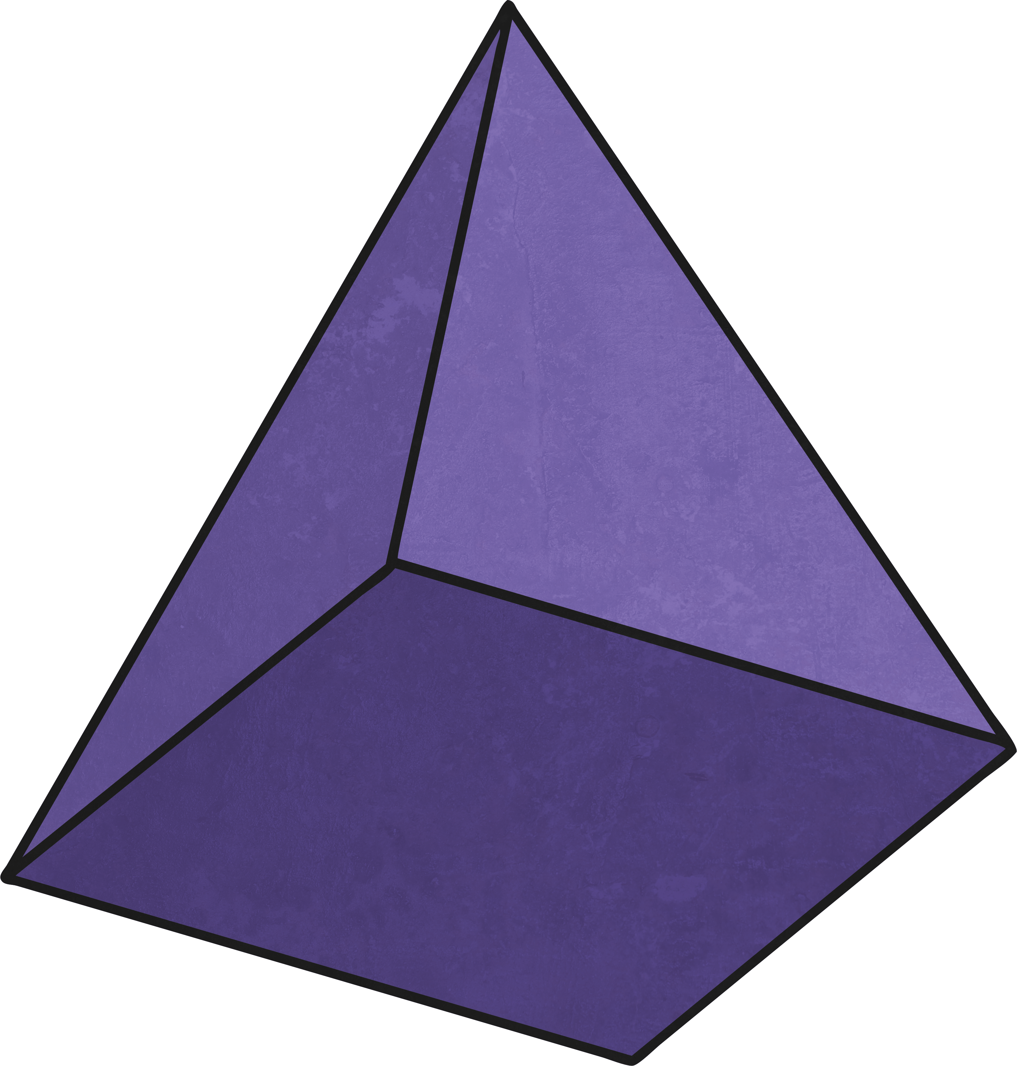
Recognise and Describe 3D Shapes
Diving
vertices
There are five vertices: four at the base and one at the top.
Count the vertices on this pyramid.
Vertices are the corners of a 3D shape, where two or more edges meet.

Slide 8
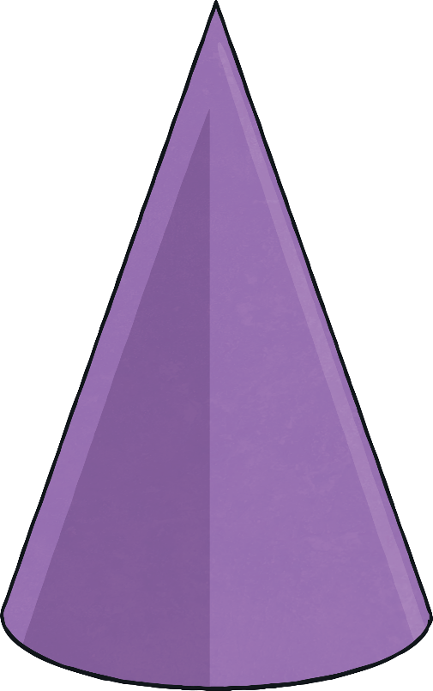
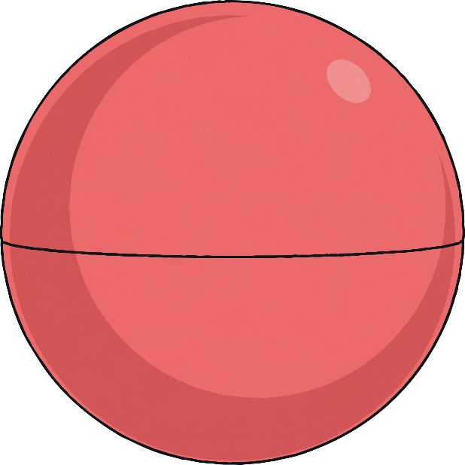
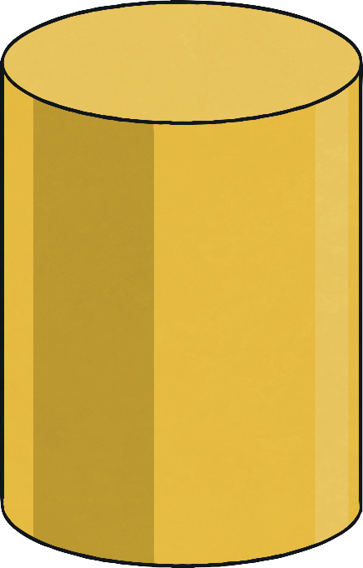
Recognise and Describe 3D Shapes
Diving
Remember that some shapes, like these, have curved surfaces.

Slide 9
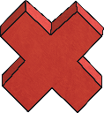
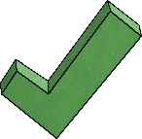
Recognise and Describe 3D Shapes
Deeper
Which of these statements are true? Click to check.
A cuboid never has a square face, only rectangular.
A pyramid always has at least one triangular face. 
A cube and a cuboid have the same number of edges, faces and vertices. 
A cylinder has no flat faces.

Slide 10
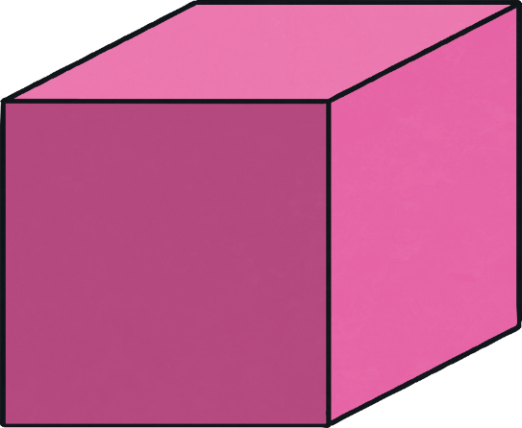
Recognise and Describe 3D Shapes
Deeper
A 3D shape has a square face.
What shape could it be?
cuboid
cube
square-based pyramid

Slide 11
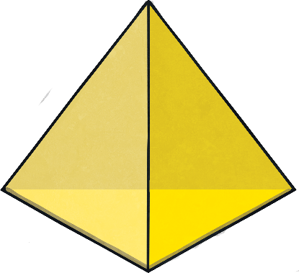
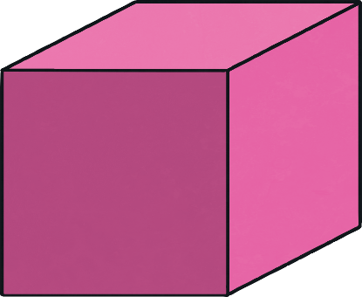
Recognise and Describe 3D Shapes
Deepest
Which shape could be the odd one out?
pyramid (tetrahedron)
cube
square-based pyramid
They could all be the odd one out!
The square has no triangular faces.
The triangular-based pyramid (tetrahedron) has no square faces.
The square-based pyramid’s faces are two different shapes.

Slide 12
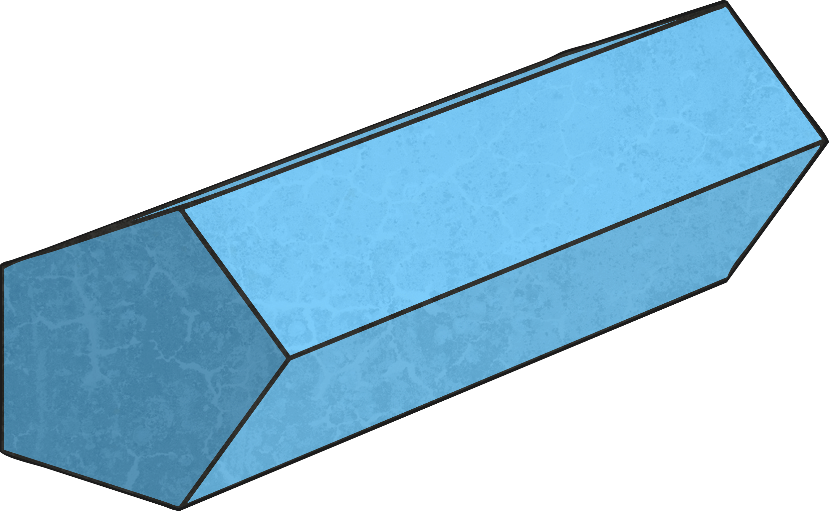
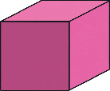
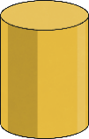
Recognise and Describe 3D Shapes
Deepest
Jay thinks that the cylinder cannot be placed in this Venn diagram.
Is she correct? Click on the shapes to sort.
The cylinder does not have 6 or more vertices or a square face so it should not go inside either of the hoops. It goes inside the rectangle.
Can you think of a different 3D shape that would go in the centre of the diagram?
square-based pyramid
pentagonal prism
cube
Has 6 or more vertices
Has a square face
cylinder

Slide 13
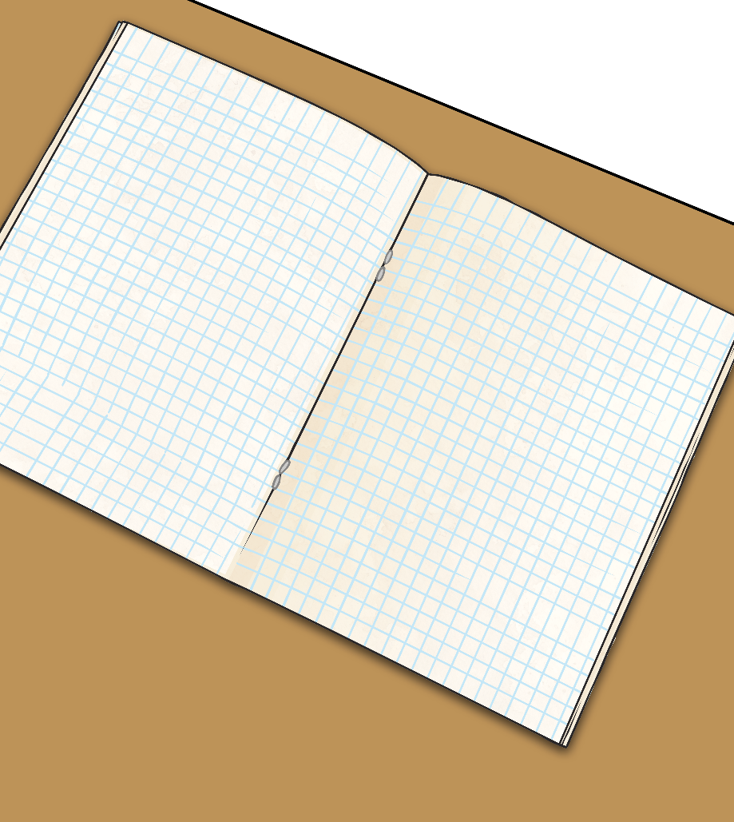
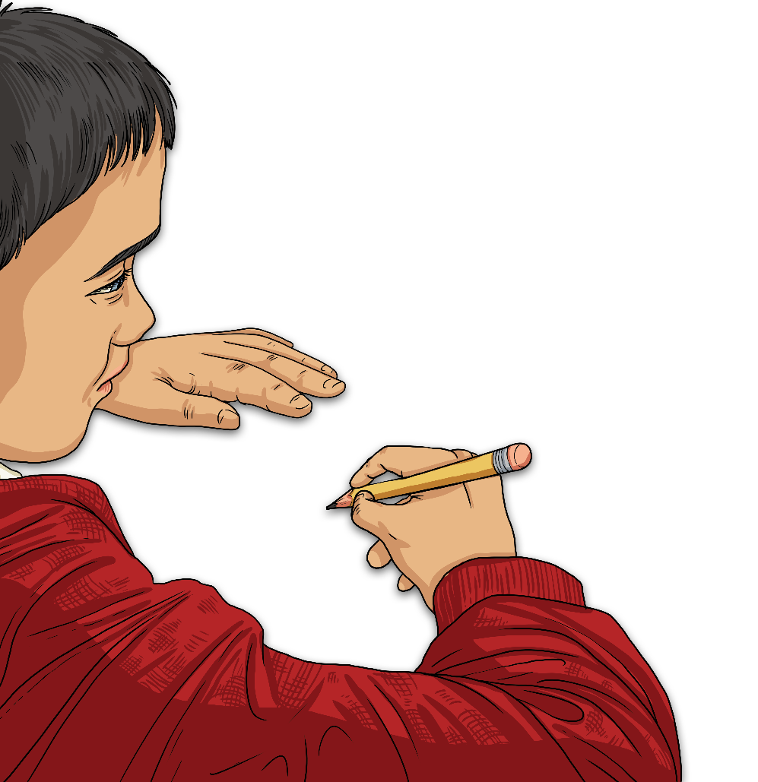
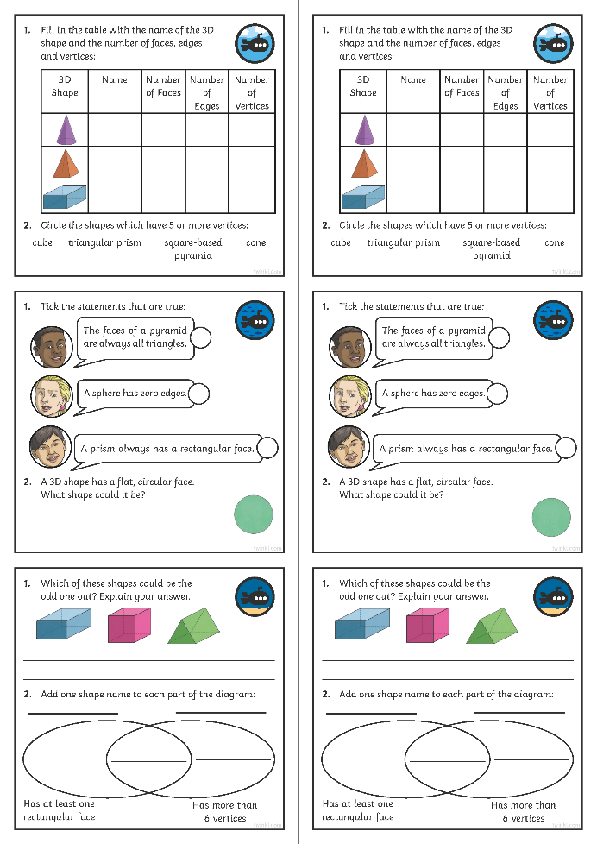
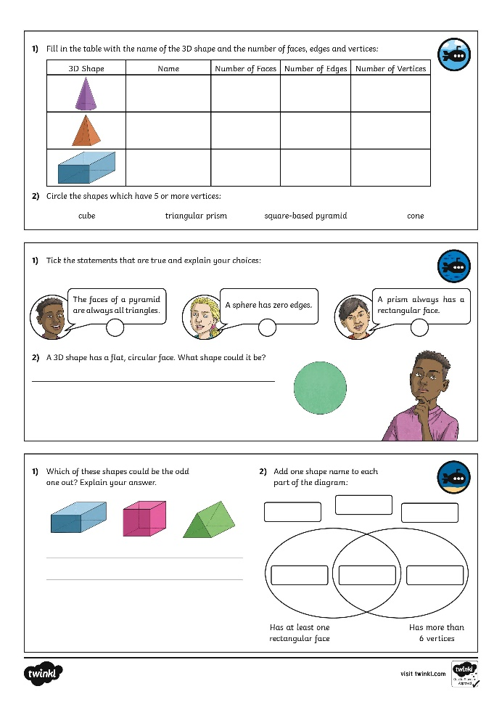
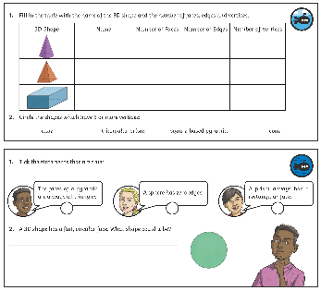
Recognise and Describe 3D Shapes
Dive in by completing your own activity!

Slide 14
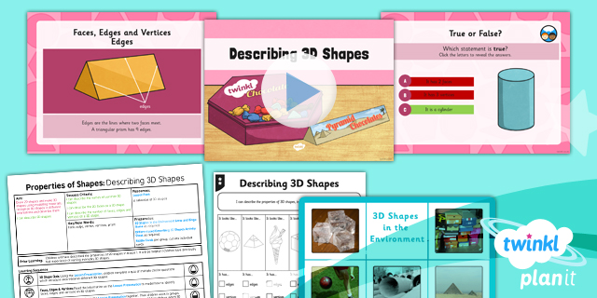
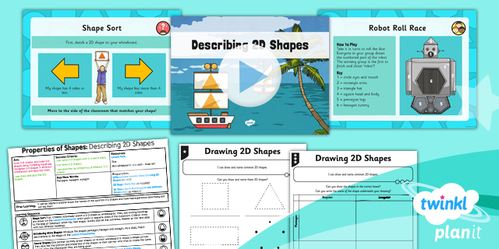
Need Planning to Complement this Resource?
National Curriculum Aim
Draw 2-D shapes and make 3-D shapes using modelling materials; recognise 3-D shapes in different orientations and describe them.
For more planning resources to support this aim, click here.
Twinkl PlanIt is our award-winning scheme of work with over 4000 resources.

